Slide 1

Job Application Management System
Mugisha ValensAUCA – Lecturer: Eric Maniraguha

Slide 2

The Challenge: Manual Application Hurdles
Traditional job application processes are often bogged down by inefficiencies. Our project addresses critical pain points faced by HR departments.
Slow & Error-Prone Processing
Manual methods lead to delays, inconsistencies, and frequent mistakes in managing applications.
Dispersed Data
Lack of centralized storage for applicant and job data creates fragmentation and accessibility issues.
Limited Tracking & Auditing
Without proper systems, tracking application progress and maintaining audit trails becomes nearly impossible.
Poor Analytics
HR struggles to generate meaningful reports or derive insights for strategic decision-making.

Slide 3

Our Solution: A PL/SQL-Based System
We propose a robust, automated system built on PL/SQL to streamline the job application process.
Centralized Management
A unified PL/SQL database for all job, applicant, and application data.
Automated Workflows
Efficient handling of job postings, application submissions, and status updates.
Data Integrity & Logging
Triggers ensure data consistency and comprehensive activity logging for compliance.
Enhanced Analytics
Built-in capabilities for business intelligence, empowering data-driven HR decisions.

Slide 4
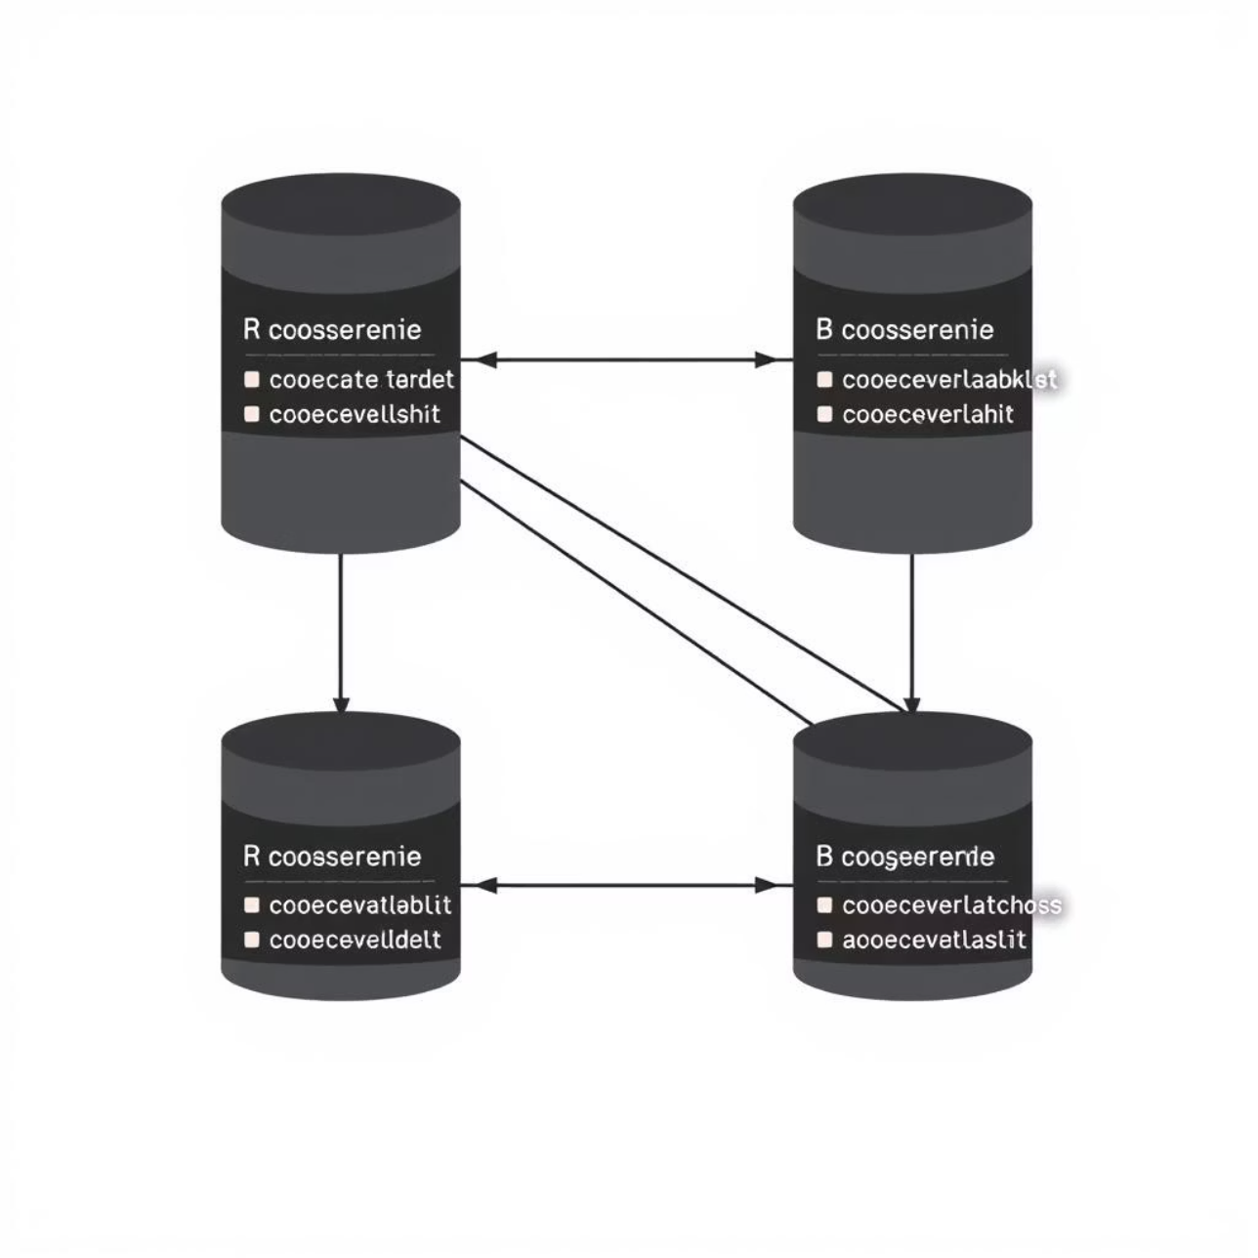
Robust Database Design
The system's foundation is a meticulously designed relational database, ensuring stability and performance.
JOBS: Stores details of all available positions.
APPLICANTS: Contains comprehensive candidate information.
JOB_APPLICATIONS: Links applicants to specific job postings and tracks application status.
APPLICATION_LOGS: Records all actions and changes within the system for auditing.
All tables are equipped with primary and foreign keys, along with appropriate constraints to maintain data integrity. The design prioritizes scalability for future growth and auditability for transparency.

Slide 5





Optimized Business Workflow
Our system automates key stages of the application process, from job creation to final disposition.
HR Creates Job
Human Resources posts new job openings within the system.
Applicant Submits
Candidates apply for relevant positions through the portal.
System Processes
Automated validation, logging, and rule enforcement occur instantly.
HR Review & Decision
HR reviews applications and makes approval or rejection decisions.
Audit & Analytics
Comprehensive audit trails and performance analytics are generated.

Slide 6
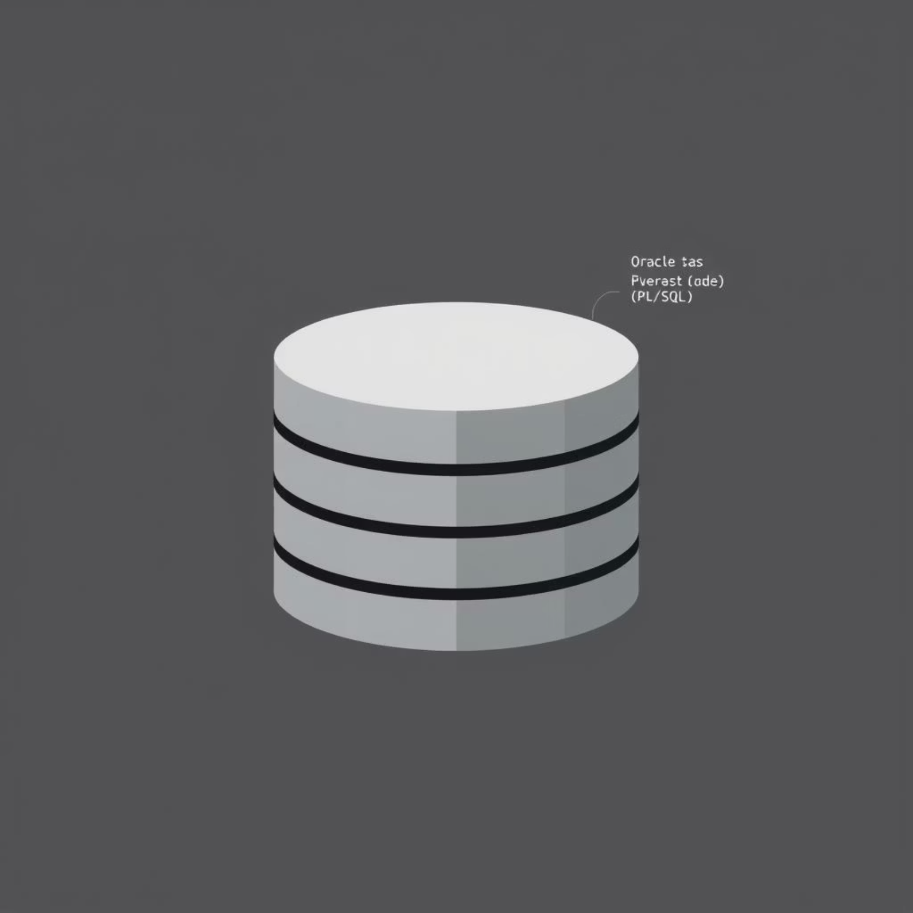
Core Technical Implementation
The system leverages powerful Oracle technologies for robust performance and flexibility.
Database Environment
The backend is powered by Oracle Database 21c/23c, utilizing a Pluggable Database (PDB) named mon_27801_valens_jobApplication_db for isolation and manageability.
PL/SQL Components
Packages: Modularized code for managing job postings, applicants, and applications.
Procedures & Functions: Encapsulated business logic and data manipulation routines.
Triggers: Automated actions for data integrity, logging, and business rule enforcement.
Advanced SQL: Utilizing Window functions and Cursors for complex data retrieval and processing.

Slide 7



Enhancing System Reliability
Beyond basic functionality, the system incorporates advanced features to ensure data quality and operational security.
Weekend & Holiday Restrictions
Comprehensive Audit Logging
A trigger prevents job applications from being processed on non-working days, ensuring accuracy in timelines.
Every significant system event is recorded, providing a complete historical record for accountability and analysis.
Robust Error Handling
Secure Access Controls
Built-in mechanisms catch and manage errors gracefully, preventing system crashes and ensuring data consistency.
Role-based security with defined privileges ensures that users only access authorized functionalities.

Slide 8
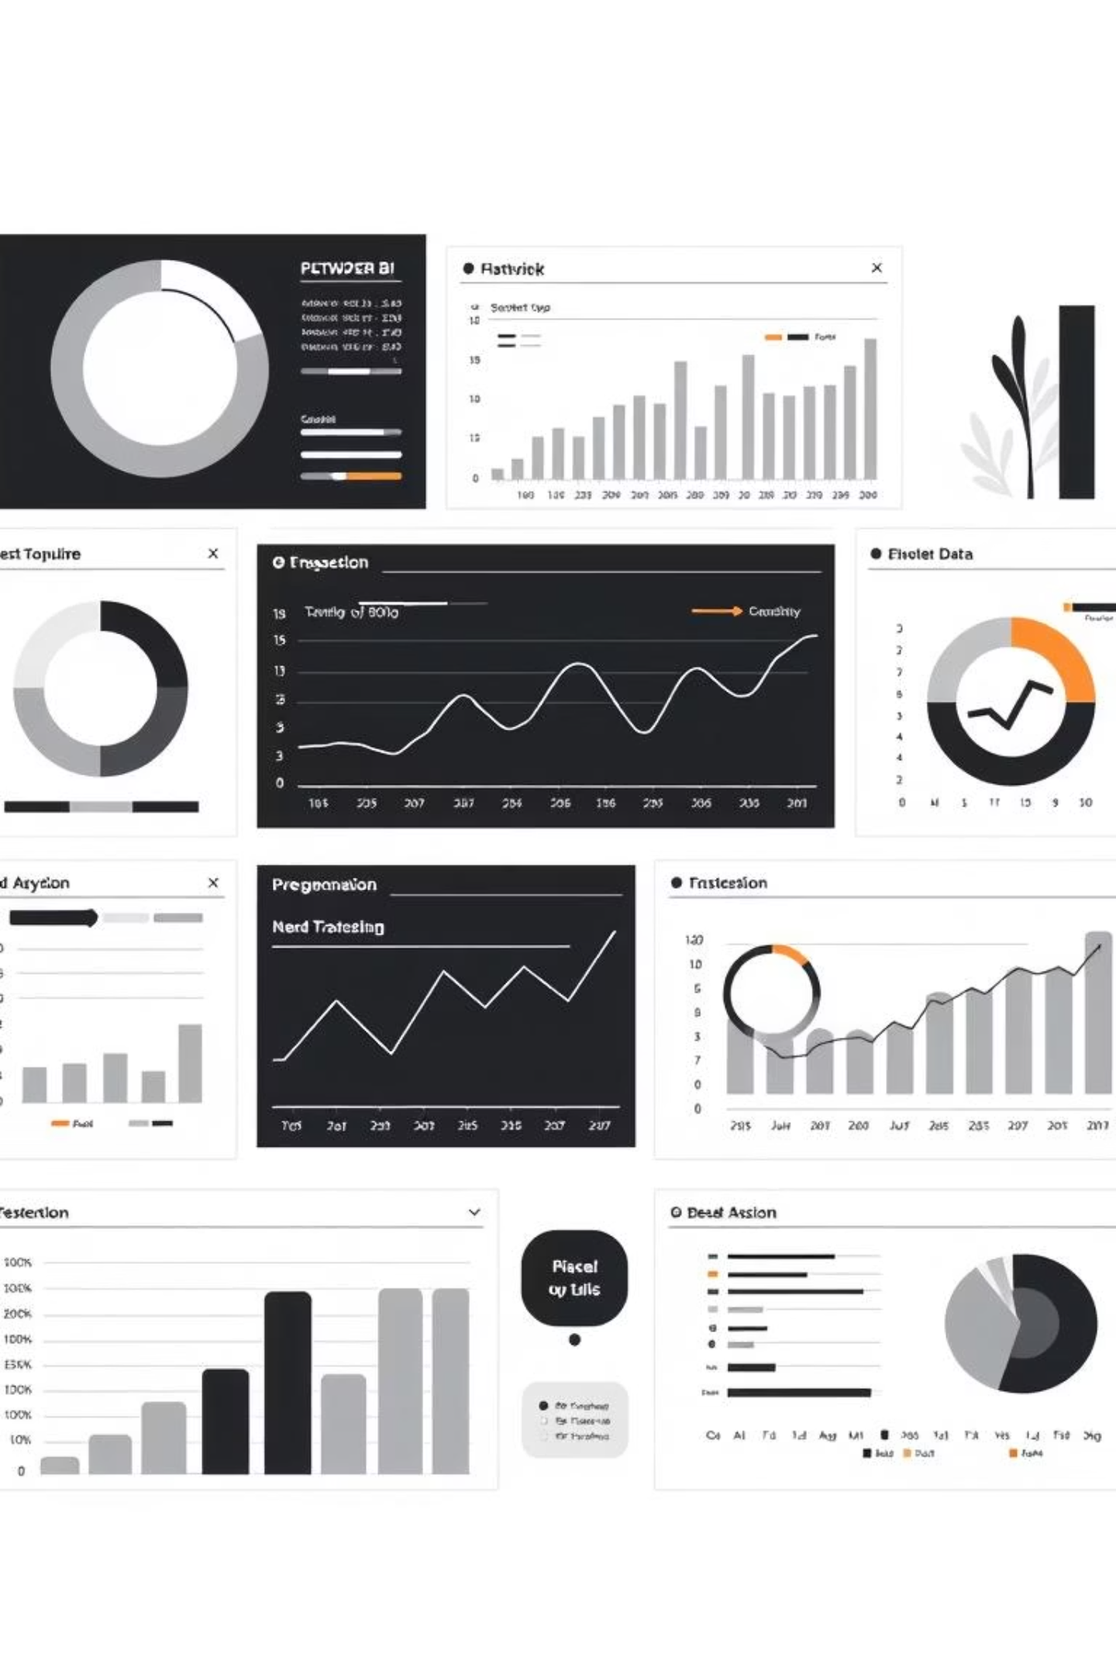
Driving Decisions with BI & Analytics
The system provides HR with crucial insights through real-time data analysis.
Key Performance Indicators (KPIs)
Analytical Capabilities
SQL Analytical Queries: Complex queries generate detailed reports from raw data.
Job Counts: Overview of active and closed positions.
Applicant Statistics: Demographics, source, and funnel progression.
Power BI Integration (Proposed): Future plans include developing an interactive dashboard for visual data representation and exploration.
Daily Application Trends: Volume and peak times for application submissions.

Slide 9
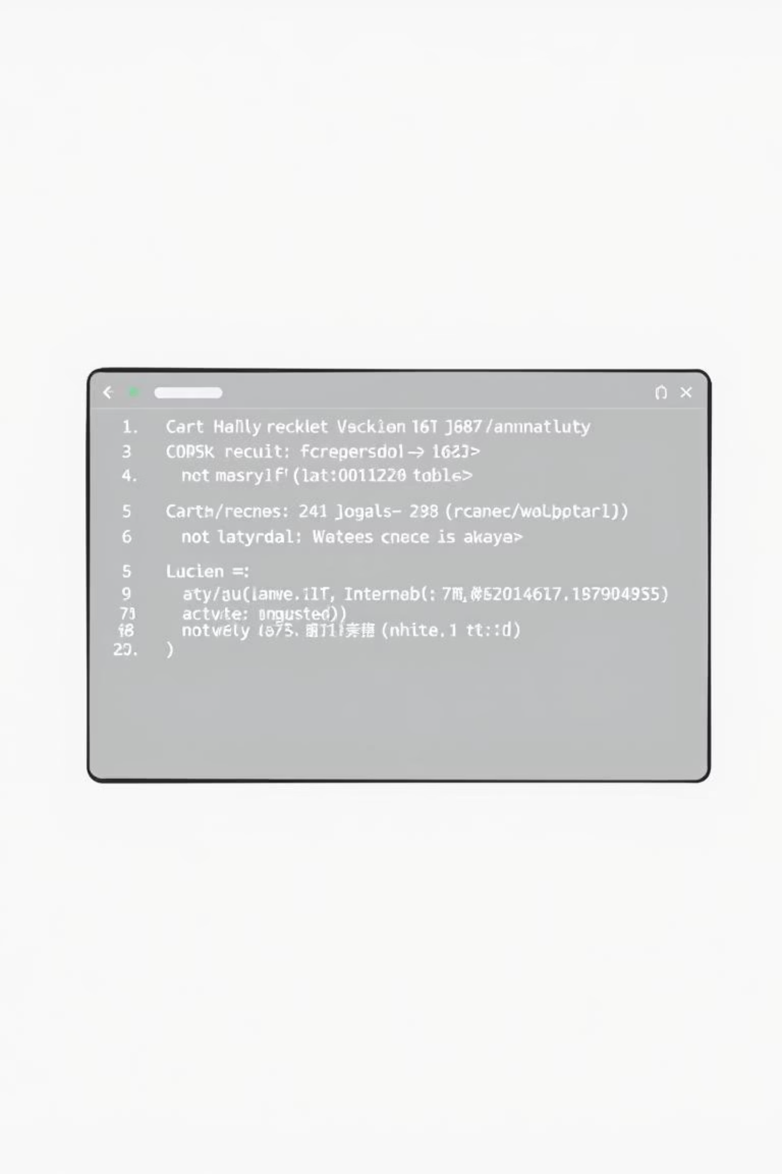

Successful Test Results
Rigorous testing confirms the system's functionality, reliability, and adherence to design specifications.
Procedure Validation
All PL/SQL procedures executed successfully, performing intended operations.
Automated Logging
Triggers demonstrated automatic and accurate insertion of audit logs.
Data Integrity Verified
Constraints and indexes were confirmed to enforce data rules effectively.
Sample Screenshots
Evidence of successful operations and data displays are included in detailed documentation.

Slide 10
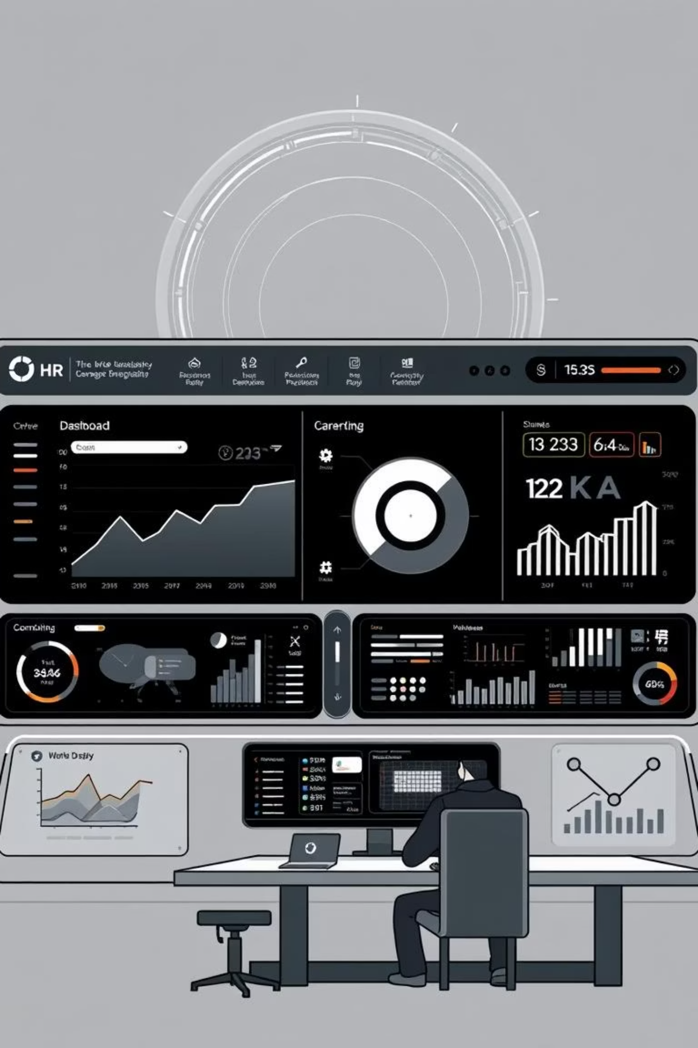
Conclusion & Future Vision
Our project delivers a robust, efficient, and intelligent job application management system.
Automated Workflow
Streamlined job application process, reducing manual effort and errors.
Enhanced Data Quality
Improved integrity and comprehensive auditing capabilities.
Real-time Insights
Empowering HR with immediate access to critical analytics.
Future: UI & Dashboard
Integration with a user interface and a complete Power BI dashboard for enhanced usability and visualization.

